Slide 1
MongoDB Datatypes
--Govardhan R S

Slide 2
Datatypes
1.Text
2.Boolean
3.Number
4.Object
5.Embedded
6.Array
7.Date
8.Null

Slide 3
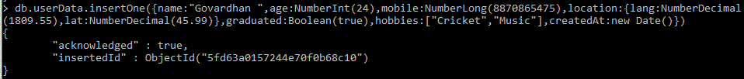
Creation

Slide 4
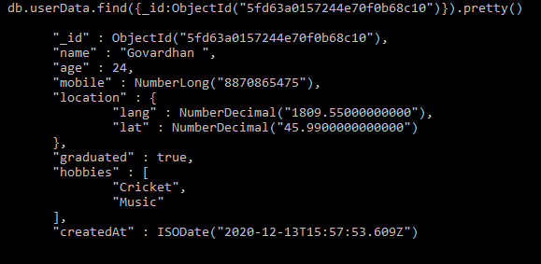
Finding

